Slide 1
Coast Survey Development Laboratory
Office of Coast Survey
National Ocean Service
National Oceanic and Atmospheric Administration
New dataCodingFormat for time series in S-100 Part 10c
Greg Seroka and Kurt Hess (TWCWG)
S-100WG5 4.18: S-100 Change Proposal

Slide 2
Summary
4.18A: S-100 Proposal - Extension to Part 10c
New dataCodingFormat to support time series
4.18B: S-100 Proposal - Clarifications to Part 10c
General editorial corrections
4.18C: Part 10c redline for both
Remaining slides cover 4.18A…

Slide 3
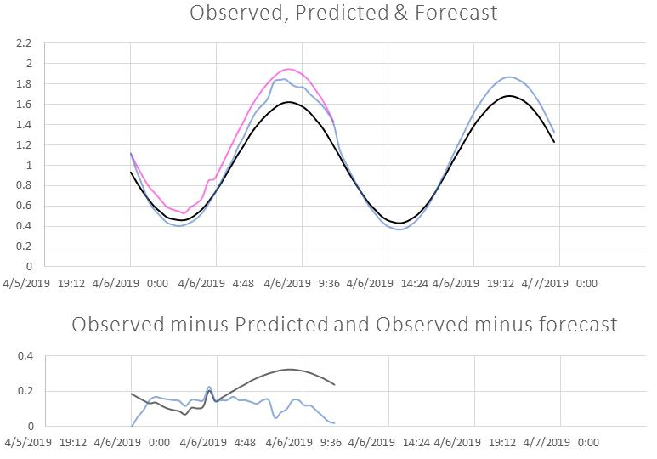
New dataCodingFormat
A new dataCodingFormat for fixed station time series is proposed, organized by station rather than time:
Motivated by S-104 use case of graphic plot of multiple time series
all times at one station
dataCodingFormat=1 Fixed station time series | New dataCodingFormat=8 Fixed station (stationwise) time series
Group_001=Data at Time No. 1 values across all stations | Group_001=Data at Station No. 1 values across all times
Group_002=Data at Time No. 2 values across all stations | Group_002=Data at Station No. 2 values across all times
etc. | etc.

Slide 4
dataCodingFormat comparison
dataCodingFormat = 1:
supports animation of real-time data (display all station values at one time, then animate through time)
but…can’t easily handle different start/end times, different time intervals
can’t easily handle non-uniform time intervals (and S-100 doesn’t say how to handle these)
is inefficient in storing one values group per time, especially for longer time series
e.g. 1 yr of 6-min predicted water level data = 87,600 values groups
dataCodingFormat = 8:
handles well different start/end times, intervals, non-uniform intervals
better supports longer time series
better supports graphical products (e.g. graphic plot)

Slide 5
S-100 Change Proposal
Change proposal form mainly includes adding wording for new dataCodingFormat=8
A few changes involve introducing a new table for values group attributes, including support for non-uniform time intervals:
Table 10c-19 – Attributes of values groups
No | Name | Camel Case
dataCodingFormat = 1, 2, 3, 5, 6 or 7
1 | Time stamp | timePoint
dataCodingFormat = 8
1 | Name of the station | stationName
2 | Station identification number | stationNumber
3 | Number of time records | numberOfTimes
4 | Index for time interval | timeIntervalIndex
5 | Time interval | timeRecordInterval
6 | Valid time of earliest value | startDateTime
7 | Valid time of latest value | endDateTime
 | (additional attributes) | (as specified in Product Specification)
for non-uniform intervals

Slide 6
S-100 Change Proposal
The S-100 WG is invited to:
Discuss the changes
If agreed upon, endorse the extension (4.18A) and clarifications (4.18B) to Part 10c
Take other actions as appropriate

Slide 7
Supplementary Slides

Slide 8
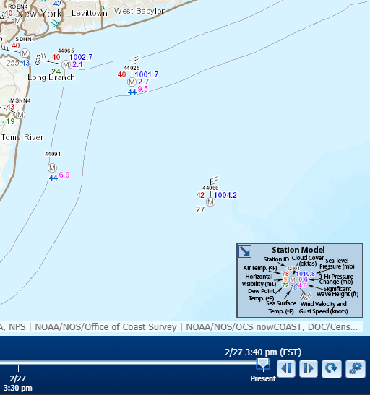
dataCodingFormat=1 use case
dataCodingFormat = 1 structured to support animation of real-time data (display all point values at one time and then animate through time)
all stations at one or a few times:
dataCodingFormat=1 Fixed station time series
Group_001=Data at Time No. 1 values across all stations
Group_002=Data at Time No. 2 values across all stations
etc.

Slide 9
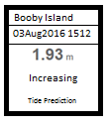
S-104 Use Cases for Time Series
After selection of station:
Use Case 1: Pick report
Use Case 2: Graphic plot of multiple time series
Time series may have different start/end
times, # records
Series have different types: prediction, etc.
Series may have variable time intervals
S-100 Ed. 4.0.0 Part 10c-6 mentions as a goal that the S-100 HDF5 profile must apply to “either static data or time series data (for any of the other kinds), with fixed or variable intervals.”
S-100 does not say how to support this type of data
Pick report
Graphic plot
Notes:
-pick report: display of a graphic showing station name, valid date and time (local or UTC), water level height and trend, and type of water level data
-graphic plot: plots of multiple types of time series data over a specific time period. Type of data (observation, prediction, etc) represented by line colour
-In graphic plot, time series of different types of water level shown from one station (e.g. obs, pre, fcst)

Slide 10
Sample S-104 File: dataCodingFormat=8
S-104 HDF5 File
Feature Container: WaterLevel
Feature Instance: WaterLevel.01 (predictions only)
Values: Group_001=Data for Station No. 1
Values: Group_002=Data for Station No. 2
Feature Instance: WaterLevel.02 (observations only)
Values: Group_001=Data for Station No. 2
Feature Instance: WaterLevel.03 (forecasts only)
Values: Group_001=Data for Station No. 2
Notes:
We introduced the use cases in previous slide. Here is a sample S-104 HDF5 file for fixed station (stationwise) time series that accommodates the use cases.
For pick report for Station 1, height and trend will come from only available series, the predictions.
For pick report for Station 2, height and trend will be available from one of three possible series.
For graphic plot for Station 1, the time series of predicted height values will be plotted; trend is not plotted.
For graphic plot for Station 2, all available (three) time series heights (but not trends) will be plotted, unless an option exists for deselection of some series. The colour and line type (solid, dashed, dotted, etc.) for each series is to be defined in the S-104 Product Specification.

